Slide 1






Target Dataset Exploration
An Sql and Python approach
Riya shivolkar
Coordinator: Kashish Agrawal

Slide 2


Agenda
1.
Project Overview
2.
Basic Queries
3.
Intermediate Queries
4.
Advanced Queries
5.
Key Insights
6.
Conclusion & Next Steps

Slide 3

Project Overview
Objective This project leverages SQL to handle large datasets efficiently and Python to extract insights through data visualizatio | Dataset Size The dataset contains thousands of records, including customers, orders, products, and payments, making SQL a necessity.
Why SQL? Since the dataset is massive, SQL enables fast querying, filtering, and aggregations before loading it into Python. | Data Processing Workflow SQL is used for retrieving and processing structured data, while Python is used for further analysis and visualization.
Why Python? Python provides powerful data visualization tools like Matplotlib and Seaborn, making it easier to analyze trends and patterns. | Business Insights By combining SQL and Python, this project uncovers customer trends, sales performance, and retention metrics for better decision-making.
Back to Agenda Page

Slide 4

Basic Queries - 1
1. List All Unique Customer Cities
The dataset contains over 4,000 unique customer cities.
unique_cities = dataframes['customers']['customer_city'].dropna().unique()
df_unique_cities = pd.DataFrame(unique_cities, columns=['Customer City'])
df_unique_cities
select distinct(customer_city) from customers;
Back to Agenda Page

Slide 5
Basic Queries - 2
2. Count the number of orders placed in 2017.
A total of 45,101 orders were placed in 2017
dataframes['orders']['order_purchase_timestamp'] = pd.to_datetime(dataframes['orders']['order_purchase_timestamp'], errors='coerce')
orders_2017 = dataframes['orders'][dataframes['orders']['order_purchase_timestamp'].dt.year == 2017]
total_orders_2017 = len(orders_2017)
print(f"Total orders placed in 2017: {total_orders_2017}")
select count(order_id) from orders where year(order_purchase_timestamp)=2017;
Back to Agenda Page

Slide 6
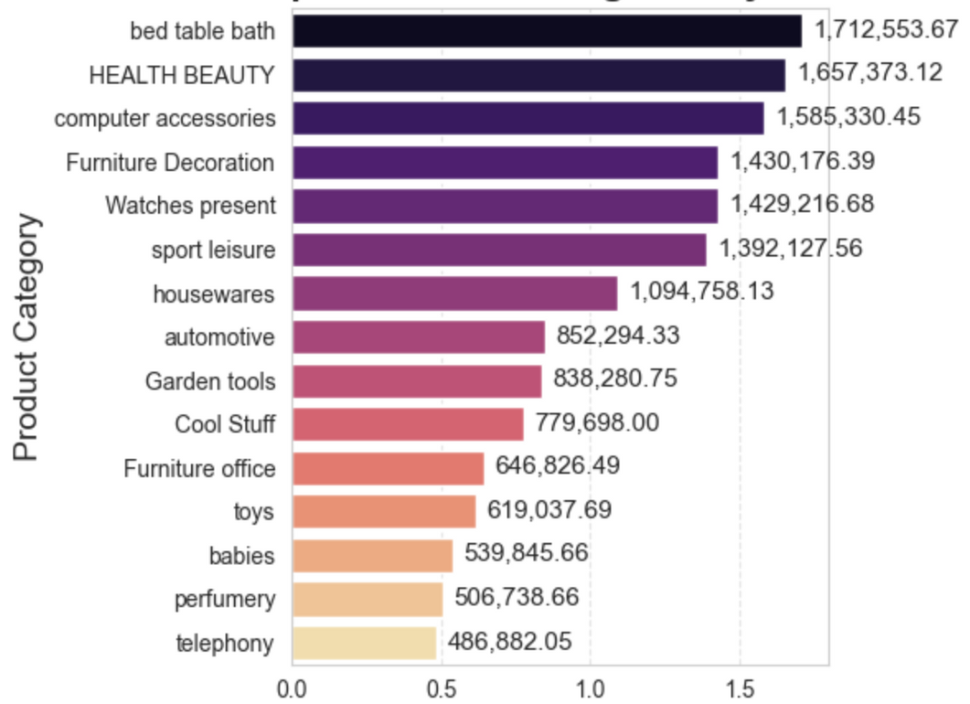
Basic Queries - 3
3. Total Sales Per Category
Among all product categories, Bed, Table & Bath generated the highest revenue, Figure 1.0
merged_df = dataframes['order_items'].merge(dataframes['products'], on='product_id').merge(dataframes['payments'], on='order_id')
df_sales = merged_df.groupby('product_category', as_index=False)['payment_value'].sum()
df_sales['payment_value'] = df_sales['payment_value'].round(2)
df_sales.columns = ['Category', 'Sales']
df_sales
Figure 1.0
SELECT products.product_category_name AS category,
ROUND(SUM(payments.payment_value), 2) AS sales
FROM products
JOIN order_items ON products.product_id = order_items.product_id
JOIN payments ON payments.order_id = order_items.order_id
GROUP BY category;
Back to Agenda Page

Slide 7
Basic Queries - 4
4. Percentage of Installment Payments
Installment payments are extremely popular, with 99.9981% of orders paid in installments.
percentage_installments = (dataframes['payments']['payment_installments'] >= 1).sum() / len(dataframes['payments']) * 100
print("The percentage of orders that were paid in installments is", round(percentage_installments, 4))
SELECT (SUM(CASE WHEN payment_installments >= 1 THEN 1 ELSE 0 END) / COUNT(*)) * 100
FROM payments;
Back to Agenda Page

Slide 8
Basic Queries - 5
5. Count the number of customers from each state.
df_customers = dataframes['customers']
df_state_counts = df_customers.groupby('customer_state', as_index=False)['customer_id'].count()
df_state_counts.columns = ['State', 'Customer Count']
df_state_counts = df_state_counts.sort_values(by='Customer Count', ascending=False)
SELECT customer_state, COUNT(customer_id) AS customer_count
FROM customers
GROUP BY customer_state;
Back to Agenda Page

Slide 9
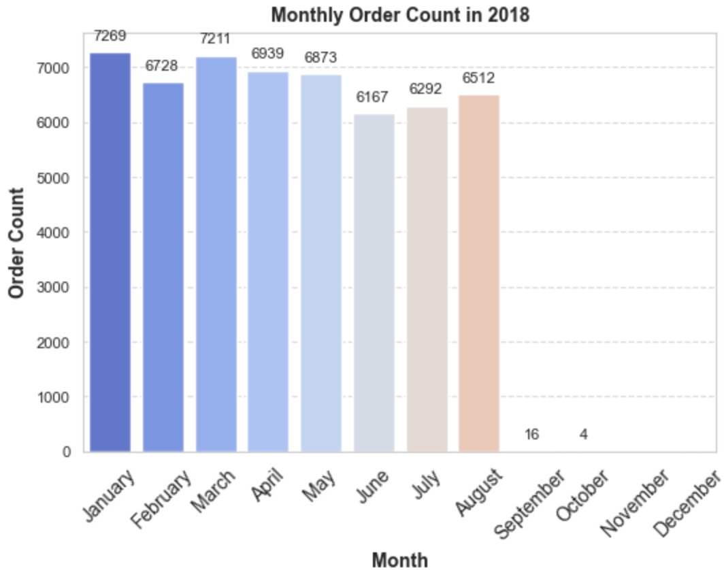
Intermediate Queries - 1
1. Number of Orders Per Month 2018
Sales fluctuate seasonally, peaking in January (7,269 orders) and March (7,211 orders), with a drop in November and December (0 orders).
df_orders = dataframes['orders']
df_orders['order_purchase_timestamp'] = pd.to_datetime(df_orders['order_purchase_timestamp'], errors='coerce')
df_2018 = df_orders[df_orders['order_purchase_timestamp'].dt.year == 2018]
df_monthly_orders = df_2018.groupby(df_2018['order_purchase_timestamp'].dt.month_name())['order_id'].count().reset_index()
df_monthly_orders.columns = ['months', 'order_counts']
month_order = ["January", "February", "March", "April", "May", "June",
"July", "August", "September", "October", "November", "December"]
df_monthly_orders['months'] = pd.Categorical(df_monthly_orders['months'], categories=month_order, ordered=True)
df_monthly_orders = df_monthly_orders.sort_values('months')
SELECT monthname(order_purchase_timestamp) AS months,
COUNT(order_id) AS order_count
FROM orders
WHERE YEAR(order_purchase_timestamp) = 2018
GROUP BY months;
Competitive Edge 1
Explain what sets you apart from your competitors.

Slide 10
Intermediate Queries - 2
2. Average Products Per Order by City
Padre Carvalho (7 avg. products), Celso Ramos (6.5), and Datas (6) lead in average order size, suggesting a pattern in consumer behavior.
order_items = dataframes['order_items']
orders = dataframes['orders']
customers = dataframes['customers']
count_per_order = orders.merge(order_items, on='order_id').groupby(['order_id', 'customer_id']).size().reset_index(name='oc')
df_avg_orders = customers.merge(count_per_order, on='customer_id').groupby('customer_city', as_index=False)['oc'].mean()
df_avg_orders.columns = ['Customer City', 'Average Products Per Order']
df_avg_orders['Average Products Per Order'] = df_avg_orders['Average Products Per Order'].round(2)
top_cities = df_avg_orders.sort_values(by='Average Products Per Order', ascending=False).head(10)
WITH count_per_order AS (
SELECT orders.order_id, orders.customer_id, COUNT(order_items.order_id) AS oc
FROM orders
JOIN order_items ON orders.order_id = order_items.order_id
GROUP BY orders.order_id, orders.customer_id
)
SELECT customers.customer_city, ROUND(AVG(count_per_order.oc), 2) AS average_orders
FROM customers
JOIN count_per_order ON customers.customer_id = count_per_order.customer_id
GROUP BY customers.customer_city
ORDER BY average_orders DESC;

Slide 11
Intermediate Queries - 3
3. Revenue Percentage Per Product Category
The Bed, Table & Bath category contributes 13.4% of the total revenue, making it the highest-earning category
products = dataframes['products']
order_items = dataframes['order_items']
payments = dataframes['payments']
merged_df = order_items.merge(products, on='product_id').merge(payments, on='order_id')
total_sales = merged_df['payment_value'].sum()
df_sales_percentage = merged_df.groupby('product_category', as_index=False)['payment_value'].sum()
df_sales_percentage['sales_percentage'] = round((df_sales_percentage['payment_value'] / total_sales) * 100, 2)
df_sales_percentage = df_sales_percentage[['product_category', 'sales_percentage']].sort_values(by='sales_percentage', ascending=False)
df_sales_percentage['product_category'] = df_sales_percentage['product_category'].str.title()
top_categories = df_sales_percentage.head(10)
SELECT
products.product_category_name AS category,
round((SUM(payments.payment_value) /
(SELECT SUM(payment_value) FROM payments) * 100), 2) AS sales_percentage
FROM
products
JOIN
order_items ON products.product_id = order_items.product_id
JOIN
payments ON payments.order_id = order_items.order_id
GROUP BY
products.product_category_name
ORDER BY
sales_percentage DESC;
Back to Agenda Page

Slide 12
Intermediate Queries - 4
4. Correlation Between Product Price & Number of Purchases
The correlation between product price and purchase frequency is -0.1063. This means that higher-priced products are slightly less frequently purchased.
products = dataframes['products']
order_items = dataframes['order_items']
df = order_items.merge(products, on='product_id').groupby('product_category', as_index=False).agg(
order_count=('product_id', 'count'),
price=('price', 'mean')
)
df['price'] = df['price'].round(2)
correlation = np.corrcoef(df['order_count'], df['price'])[0, 1]
print('The correlation between product price and the number of times a product has been purchased:', round(correlation, 4))
select products.product_category,
count(order_items.product_id),
round(avg(order_items.price),2)
from products join order_items
on products.product_id = order_items.product_id
group by products.product_category;
Back to Agenda Page

Slide 13
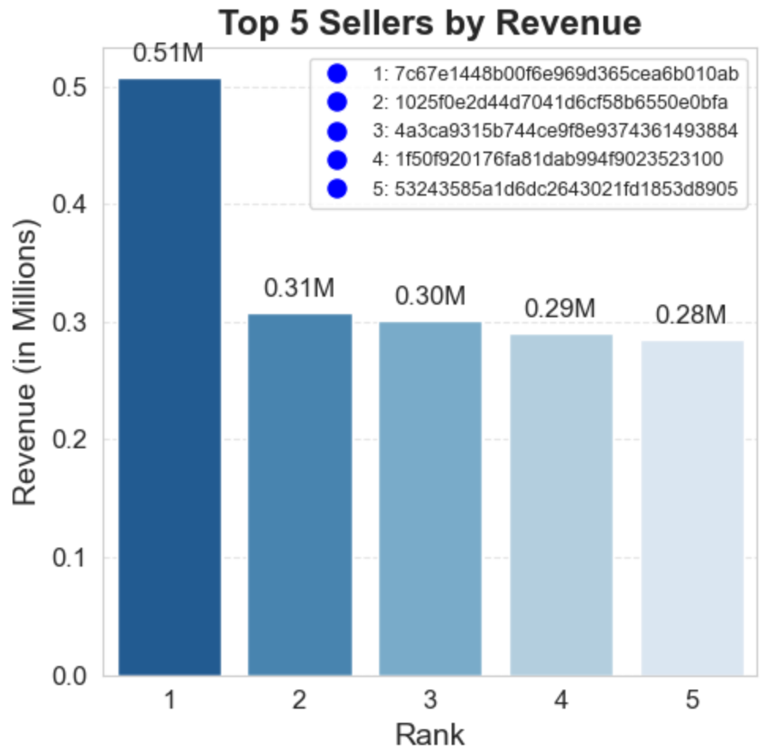
Intermediate Queries - 5
5. Total Revenue Per Seller & Ranking
The top-performing sellers generated a combined revenue of $0.51 million. Identifying these sellers helps businesses form better partnerships and target high-value sellers for growth opportunities.
order_items = dataframes['order_items']
payments = dataframes['payments']
sellers = dataframes['sellers']
df_revenue = order_items.merge(payments, on='order_id').merge(sellers, on='seller_id')
df_revenue = df_revenue.groupby('seller_id', as_index=False)['payment_value'].sum()
df_revenue.columns = ['seller_id', 'revenue']
df_revenue = df_revenue.sort_values(by='revenue', ascending=False).head(5)
df_revenue['index'] = range(1, len(df_revenue) + 1)
seller_id_mapping = df_revenue.set_index('index')['seller_id'].to_dict()
SELECT *, dense_rank() OVER(ORDER BY revenue DESC) AS rn FROM (
SELECT order_items.seller_id,
SUM(payments.payment_value) / 1e6 AS revenue -- Convert to millions (M)
FROM order_items
JOIN payments ON order_items.order_id = payments.order_id
GROUP BY order_items.seller_id
) AS a;

Slide 14
Advanced Queries -1
orders = dataframes['orders']
payments = dataframes['payments']
df_orders = orders.merge(payments, on='order_id')[['customer_id', 'order_purchase_timestamp', 'payment_value']]
df_orders['order_purchase_timestamp'] = pd.to_datetime(df_orders['order_purchase_timestamp'], errors='coerce')
df_orders = df_orders.sort_values(by=['customer_id', 'order_purchase_timestamp'])
df_orders['moving_avg'] = df_orders.groupby('customer_id')['payment_value'].rolling(window=3, min_periods=1).mean().reset_index(level=0, drop=True)
df_orders.columns = ['customer_id', 'order_purchase_timestamp', 'payment', 'moving_avg']
df_orders
1. Moving Average of Order Values Per Customer
With over 103,000 order records, analyzing the moving average of order values helps track spending patterns over time.
WITH CustomerOrders AS (
SELECT
o.customer_id,
o.order_purchase_timestamp,
p.payment_value AS payment
FROM
orders o
JOIN
payments p ON o.order_id = p.order_id
)
SELECT
customer_id,
order_purchase_timestamp,
payment,
AVG(payment) OVER (
PARTITION BY customer_id
ORDER BY order_purchase_timestamp
ROWS BETWEEN 2 PRECEDING AND CURRENT ROW
) AS moving_avg
FROM
CustomerOrders;
Back to Agenda Page

Slide 15
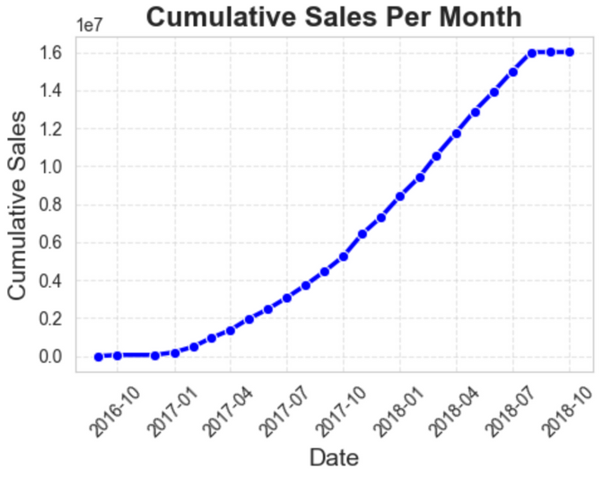
orders = dataframes['orders'][['order_id', 'order_purchase_timestamp']].copy()
payments = dataframes['payments'][['order_id', 'payment_value']].copy()
orders['order_purchase_timestamp'] = pd.to_datetime(orders['order_purchase_timestamp'], errors='coerce')
df_sales = orders.merge(payments, on='order_id', how='inner')
df_sales = df_sales.loc[:, ~df_sales.columns.duplicated()]
df_sales['Year'] = df_sales['order_purchase_timestamp'].dt.year
df_sales['Month'] = df_sales['order_purchase_timestamp'].dt.month
df_monthly_sales = df_sales.groupby(['Year', 'Month'], as_index=False)['payment_value'].sum()
df_monthly_sales = df_monthly_sales.rename(columns={'payment_value': 'Monthly Sales'})
df_monthly_sales['Cumulative Sales'] = df_monthly_sales['Monthly Sales'].cumsum()
df_monthly_sales['Date'] = pd.to_datetime(df_monthly_sales['Year'].astype(str) + '-' + df_monthly_sales['Month'].astype(str), format='%Y-%m')
select years, months, payment, sum(payment)
over(order by years, months) cummulative_sales from
(select year(orders.order_purchase_timestamp) as years,
month(orders.order_purchase_timestamp) as months,
round(sum(payments.payment_value),2) as payment from orders join payments
on orders.order_id = payments.order_id
group by years, months order by years, months) as a;
Advanced Queries -2
2. Cumulative Sales Per Month (Year-wise)
Cumulative revenue shows exponential growth, indicating consistent sales acceleration and aiding in understanding seasonality and long-term trends.
Back to Agenda Page

Slide 16



Advanced Queries -3
3. Year-over-Year Sales Growth
Sales skyrocketed in 2017 with a 12,112.7% increase compared to 2016, followed by a 20.0% growth in 2018. This dramatic jump suggests a major business expansion or increased customer acquisition strategies.
orders = dataframes['orders'][['order_id', 'order_purchase_timestamp']].copy()
payments = dataframes['payments'][['order_id', 'payment_value']].copy()
orders['order_purchase_timestamp'] = pd.to_datetime(orders['order_purchase_timestamp'], errors='coerce')
df_sales = orders.merge(payments, on='order_id', how='inner')
df_sales['Year'] = df_sales['order_purchase_timestamp'].dt.year
df_yearly_sales = df_sales.groupby('Year', as_index=False)['payment_value'].sum()
df_yearly_sales = df_yearly_sales.rename(columns={'payment_value': 'Total Sales'})
df_yearly_sales['YoY % Growth'] = ((df_yearly_sales['Total Sales'] - df_yearly_sales['Total Sales'].shift(1)) /
df_yearly_sales['Total Sales'].shift(1)) * 100
df_yearly_sales
with a as(
select year(orders.order_purchase_timestamp) as years,
round(sum(payments.payment_value),2) as payment from orders join payments
on orders.order_id = payments.order_id
group by years order by years)
select years, ((payment - lag(payment - 1) over(order by years))/lag(payment, 1) over(order by years)) * 100 from a;
Back to Agenda Page

Slide 17
Advanced Queries -4
WITH a AS (
SELECT customers.customer_id,
MIN(orders.order_purchase_timestamp) AS first_order
FROM customers
JOIN orders ON customers.customer_id = orders.customer_id
GROUP BY customers.customer_id
),
b AS (
SELECT a.customer_id,
COUNT(DISTINCT orders.order_purchase_timestamp) AS next_order
FROM a
JOIN orders ON orders.customer_id = a.customer_id
AND orders.order_purchase_timestamp > a.first_order
AND orders.order_purchase_timestamp < DATE_ADD(a.first_order, INTERVAL 6 MONTH)
GROUP BY a.customer_id
)
SELECT
100 * (COUNT(DISTINCT b.customer_id) / COUNT(DISTINCT a.customer_id)) AS repeat_purchase_rate
FROM a
LEFT JOIN b ON a.customer_id = b.customer_id;
4. Customer Retention Rate (6-Month Repurchase Rate)
The repeat purchase rate is 0.0%, meaning no customers made another purchase within 6 months of their first order. This highlights an opportunity to improve retention through loyalty programs and personalized marketing.
customers = dataframes['customers'][['customer_id']].copy()
orders = dataframes['orders'][['customer_id', 'order_purchase_timestamp']].copy()
orders['order_purchase_timestamp'] = pd.to_datetime(orders['order_purchase_timestamp'], errors='coerce')
first_orders = orders.groupby('customer_id')['order_purchase_timestamp'].min().reset_index()
first_orders = first_orders.rename(columns={'order_purchase_timestamp': 'first_order'})
df_repeat_orders = orders.merge(first_orders, on='customer_id', how='inner')
df_repeat_orders = df_repeat_orders[
(df_repeat_orders['order_purchase_timestamp'] > df_repeat_orders['first_order']) &
(df_repeat_orders['order_purchase_timestamp'] < df_repeat_orders['first_order'] + pd.DateOffset(months=6))
repeat_customers = df_repeat_orders['customer_id'].nunique()
total_customers = first_orders['customer_id'].nunique()
repeat_purchase_rate = (repeat_customers / total_customers) * 100 if total_customers > 0 else 0.0
df = pd.DataFrame({'Repeat Purchase Rate': [repeat_purchase_rate]})
df
"since the repeat purchase rate is 0.0, it means that no customer has made a repeat purchase within 6 months of their first purchase "

Slide 18
Advanced Queries -5
orders = dataframes['orders'][['order_id', 'customer_id', 'order_purchase_timestamp']].copy()
payments = dataframes['payments'][['order_id', 'payment_value']].copy()
orders['order_purchase_timestamp'] = pd.to_datetime(orders['order_purchase_timestamp'], errors='coerce')
df_sales = orders.merge(payments, on='order_id', how='inner')
df_sales['Year'] = df_sales['order_purchase_timestamp'].dt.year
df_customer_sales = df_sales.groupby(['Year', 'customer_id'], as_index=False)['payment_value'].sum()
df_customer_sales = df_customer_sales.rename(columns={'payment_value': 'Total Payment'})
df_customer_sales['Rank'] = df_customer_sales.groupby('Year')['Total Payment'].rank(method='dense', ascending=False)
df_top_customers = df_customer_sales[df_customer_sales['Rank'] <= 3]
SELECT years, customer_id, payment, d_rank
FROM (
SELECT
YEAR(orders.order_purchase_timestamp) AS years,
orders.customer_id,
SUM(payments.payment_value) AS payment,
DENSE_RANK() OVER(PARTITION BY YEAR(orders.order_purchase_timestamp)
ORDER BY SUM(payments.payment_value) DESC) AS d_rank
FROM orders
JOIN payments ON payments.order_id = orders.order_id
GROUP BY YEAR(orders.order_purchase_timestamp), orders.customer_id
) AS a
WHERE d_rank <= 3;
5. Top 3 Customers by Spending Per Year
Identifying the highest-spending customers each year can help businesses develop VIP customer strategies, offer exclusive deals, and improve customer relationship management.
Back to Agenda Page

Slide 19
Key Insights
The Bed, Table & Bath category leads in revenue, with top sellers contributing $0.51M. Orders peak in the first half of the year but drop sharply in November and December, indicating seasonal trends or engagement gaps.
To drive growth, businesses should enhance customer retention through loyalty programs and targeted marketing. Expanding best-selling categories, refining pricing strategies, and strengthening installment options will boost revenue. Leveraging data-driven insights will unlock new market opportunities and improve long-term success.
Back to Agenda Page

Slide 20

Conclusion & Next Steps
This project demonstrates how SQL efficiently handles large datasets, extracting valuable insights, while Python enhances analysis through visualization. The findings highlight seasonal trends, top-performing categories, revenue distribution, and customer behavior, enabling data-driven decision-making for business growth.
Moving forward, automating reports with Python Dash or Streamlit can streamline real-time monitoring. Implementing machine learning models can help predict future sales trends and optimize pricing strategies. Additionally, developing an interactive analytics dashboard will provide deeper insights, improving customer engagement and business performance.

Slide 21
Thank You!

